Slide 1

Plotting & Data Visualization
Module 12
Programming for Data Science
March 12, 2020 [gb]

Slide 2
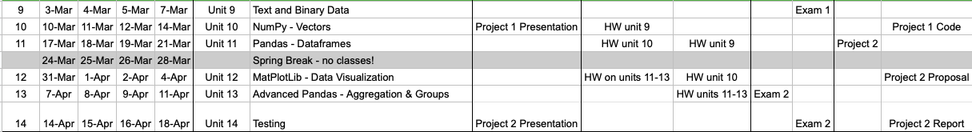
Plotting & Data Visualization
IMHO … “information” is the result of human cognition, engagement with, and establishing significance from, the data, applicable to some need, and which enables a person to explain the rationale behind the significance. Otherwise, it’s all just data.
Tendency to use as synonyms ‘cause our goal is to provide data as quickly and appropriately as possible to fulfill some need (hence “info”).
Visualization is a language for communicating & helping understand data.
Calendar

Slide 3
Plotting & Data Visualization
Data Visualization:
illustrates raw values;
delivers data in intelligible graphic forms;
offers objectivity;
suggests trends;
DataVis refers primarily to specific techniques to represent data in a visual language - graphs, plots, charts … and more.
Successful visualizations (data + design) convey an overview of the data, help you to explain the raw data, explore the data to discover new events or association, and do so in aesthetic ways that do not distract the viewers and so confuse the message.
If you get lost in creating a visual representation of your data, ask yourself what are the implications (or the “so what?” factor) and focus on that message.
Capture, clean data
Uni-, bi-, or multivariate data? Domain / Range of the data
Lend itself to expected graphics? (time series -> histograms)
Data in Visual Form + Overlaying Layers to provide context
(such as labels, legends, details-on-demand, etc.)

Slide 4
Discussion
What’s your experience with plotting & data visualization?
Any specific examples that you find helpful? How and why?
Why and when is any kind of visualization helpful?
What’s beyond data vis/plotting?
Interactive information visualization
In practice, do you see relationships between Data Science/Big Data/ Data Mining and Statistics? [SAS, SPSS, IBM, Oracle/Java, Tableau, you name it all offers white papers to inform clients of the need and their products!]

Slide 5
Discussion
What message do you want to convey through your visualizations?
Explain - show the part/whole relationship of groups and contextualize their relationships (e.g., from low to high)
Explore - visually through graphic techniques (color, placement, difference of visual elements (line, square, circle, icon, etc.)
Predict - suggest possibilities; provide warrant for trends (in data mining called an “interesting event”; statistically-sound data)
Help viewers establish meaningfulness - information!
Your choice: Use third-party products (for “business intelligence”, etc.) or use libraries to create your own visualization product (and control the visualization experience). Lots of factors impact our choices.

Slide 6

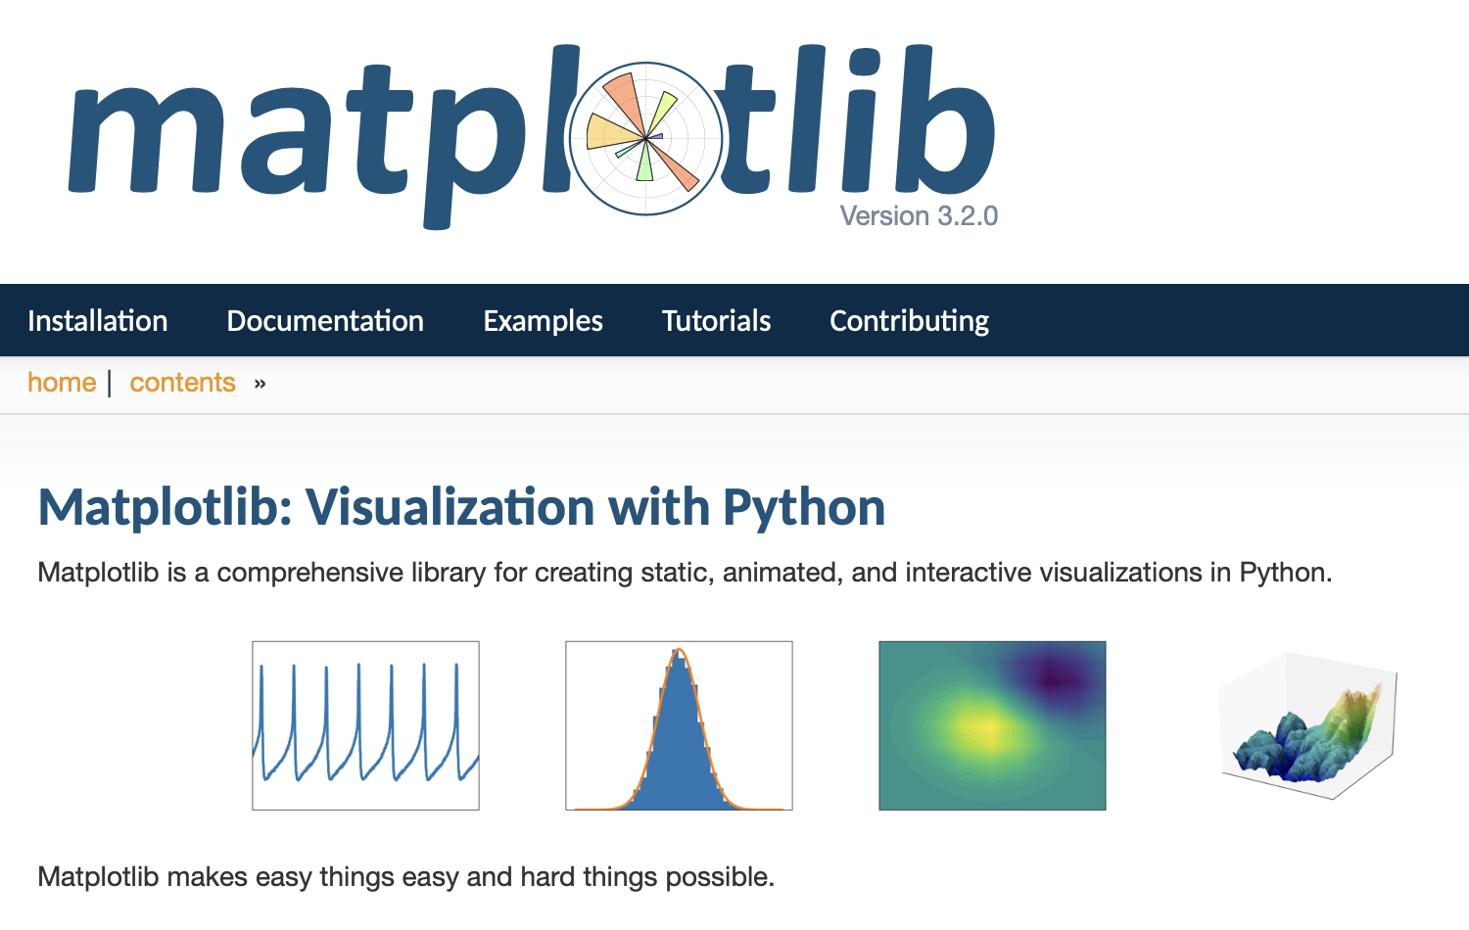

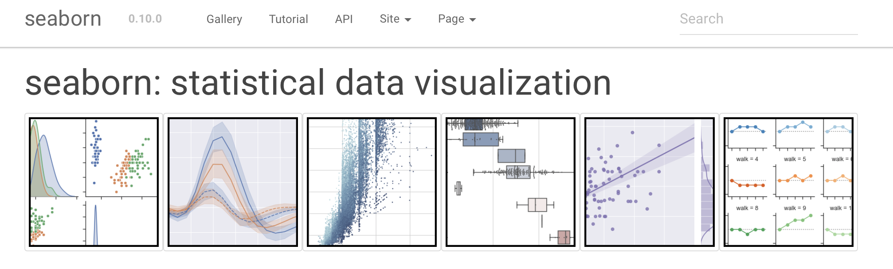
Matplotlib & Seaborn
Two of our most popular libraries for python. Use ‘em to explore your data.
https://jakevdp.github.io/PythonDataScienceHandbook/04.14-visualization-with-seaborn.html.
Here’s a great Seaborn tutorial
https://jovianlin.io/data-visualization-seaborn-part-1/

Slide 7
Other python libraries
matplotlib
seaborn [on top of matplotlib; for statistics and cool visualizations]
ggplot [library for R and python]
bokeh [interactive vis]
pygal
plotly [interactive vis]
geoplotlib [maps; chloropleth]
gleam Other projects
missingno
leather
basemap (for geographic data) [requires installing base map library; pillow (but not PIL) https://pillow.readthedocs.io/en/stable/installation.html
Another great tool of particular value is the JavaScript-oriented d3.js library. Check out Mike Bostock’s Data-Driven Documents homepage and on GitHub. By saving your analyzed and processed data; it’s easy to stream them into a file to be read later by a website calling the d3.js library.
Commercial products - Tableau is very popular.

Slide 8

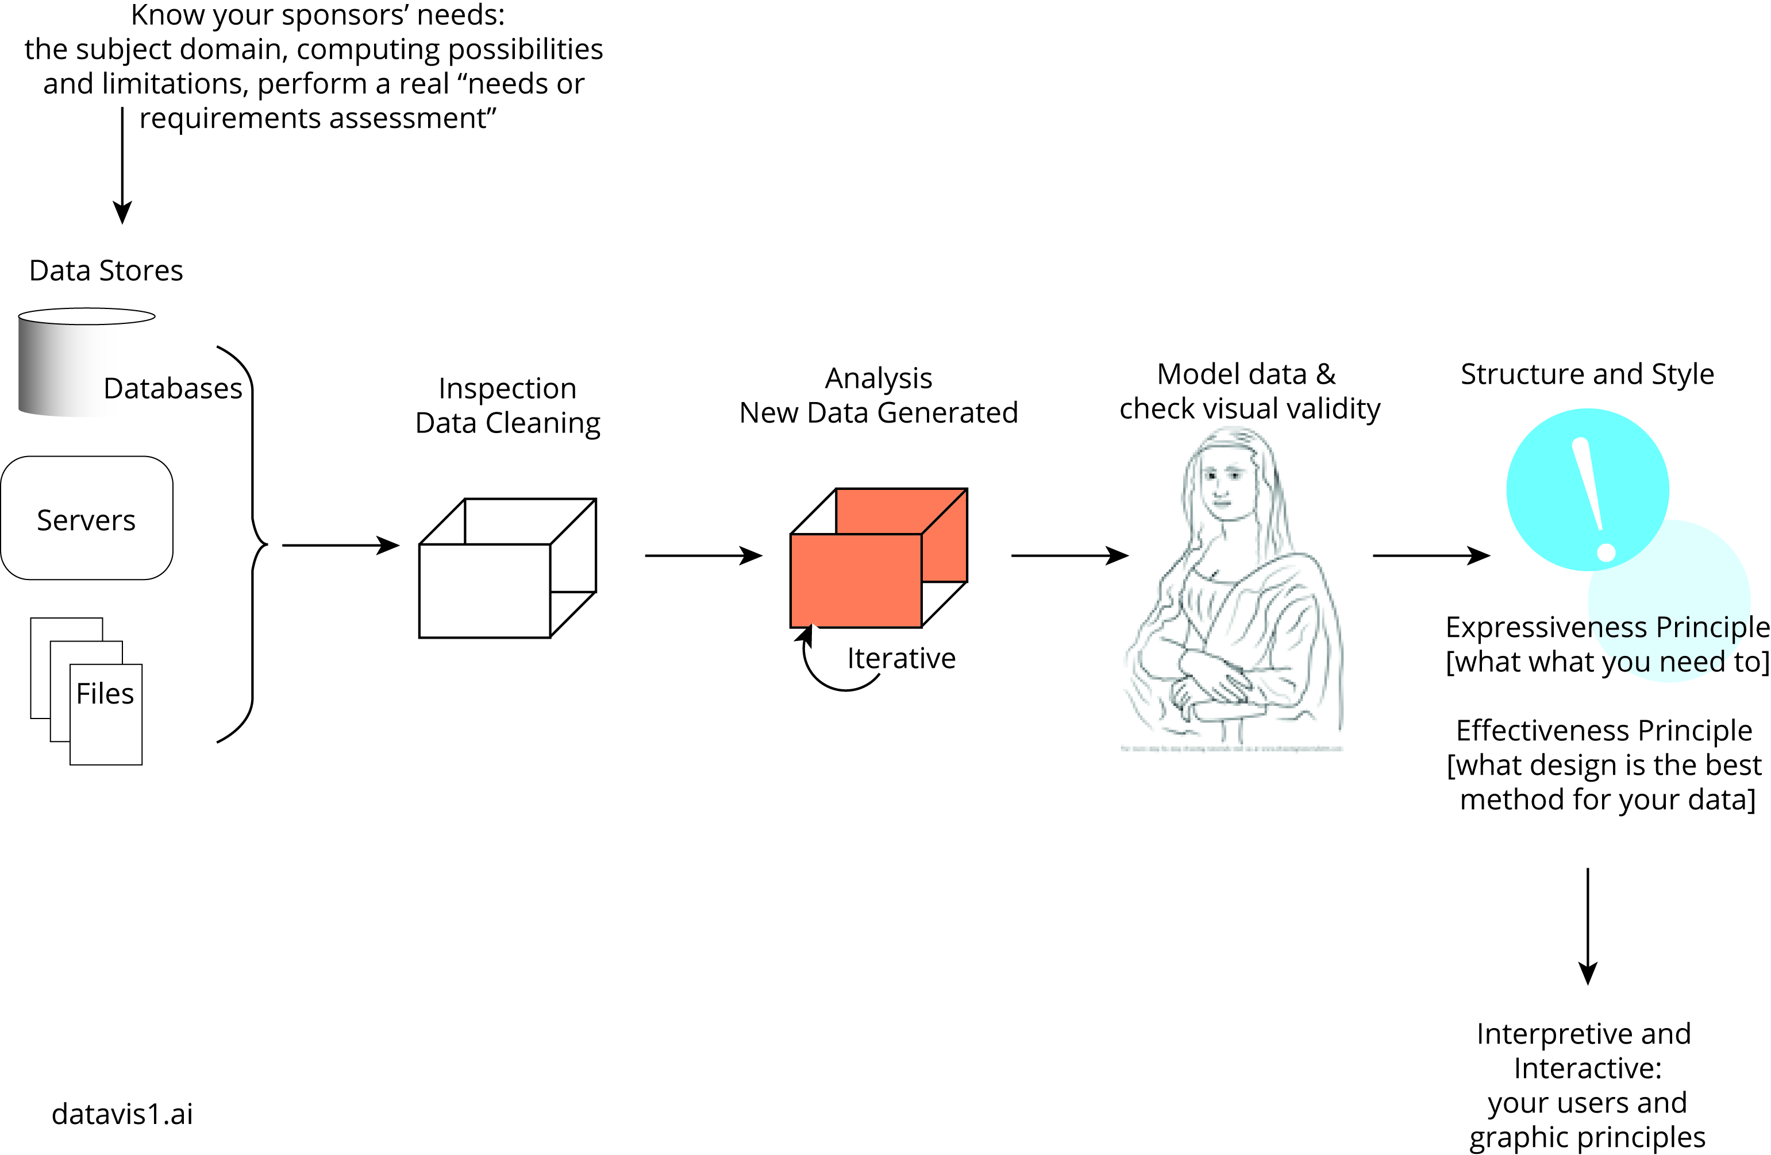
Overview of a process

Slide 9
Overview example
Using matplotlib as a the first example, let’s say your data are stored in a .csv file ... and that you’ve already checked for missing values, NaN, and values that are within range and domain, and that you know the data types of each of the columns & rows (whew!).
What data structure will hold your data? List? dictionary, NymPy array, other?
Color scheme (complementary, tritonic, analogous, etc.); visual elements (line, circle, spacing, size, placement, etc. Perhaps create a dictionary or list to hold these data.
Linear? Box plot? Heatmap? There are lots of visualization ideas. Combine this with graphic design issues.
Determine how end-users will interact with your data … use “events” to provide data-on-demand, to drill-down, brush, and other techniques to “communicate” with the data; what claims do the data make?
Know your data
Learn about the aesthetics of data; the graphic vocabulary of designing data
Review EDA and other graphic forms of data
Interactivity
EDA = Exploratory Data Analysis

Slide 10
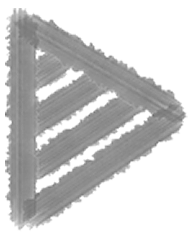
As a programmer, working from code to visual product
Sketch your design first; what data where?
Import your libraries
Adjust for your IDE (e.g., % to display inline; “retina” option NB)
Get yer data … prepare the output device to hold the visualizations.
Create a “container” to hold the viz (e.g., “figure”; compare this to HTML5’s canvas or SVG object)
Contextualize the data in a framework (axes [placement, ticks], labels [titles, subtitles, subplots])
Design a model and decide on the aesthetic elements (symbols, visual elements, colors, saturation)
Shortcuts in the code? (e.g., use the code, such as color constants, templates)
Adjust your design based on the user needs, truthfulness to interpretation of the data; test the plotted data.

Slide 11
Many visual options
Dot Graph
Stacked Bar Graph
Proportional Symbol Map
Choropleth
Force-Directed Layout
Radar Graph
Stream Graph
Parallel Coordinate
Stacked Line Graph
Box-and-Whiskers
Radial Tree
Dasymetric
Circular Graph
Tag Cloud
Line Graph
Tree View
Cartogram
Force-Directed Layout
Hive Graph
Pie Chart
Stepped Relief Map
Balloon Tree
Stripe Graph
Arc
Scatter
Bimodal
Crossmap
Steam and Leaf
Bubble Chart
Doughnut
Dot Density
Isoline
Chord
Sankey
Proportional Symbol
Treemap
Arc Graph
History Flow
Börner, K. Atlas of knowledge. MIT Press
Elevation
Histogram
Science
Isarithmic
Strip Map
Isochrome Map
Population Pyramid
Enclosure Tree
Dendrogram

Slide 12
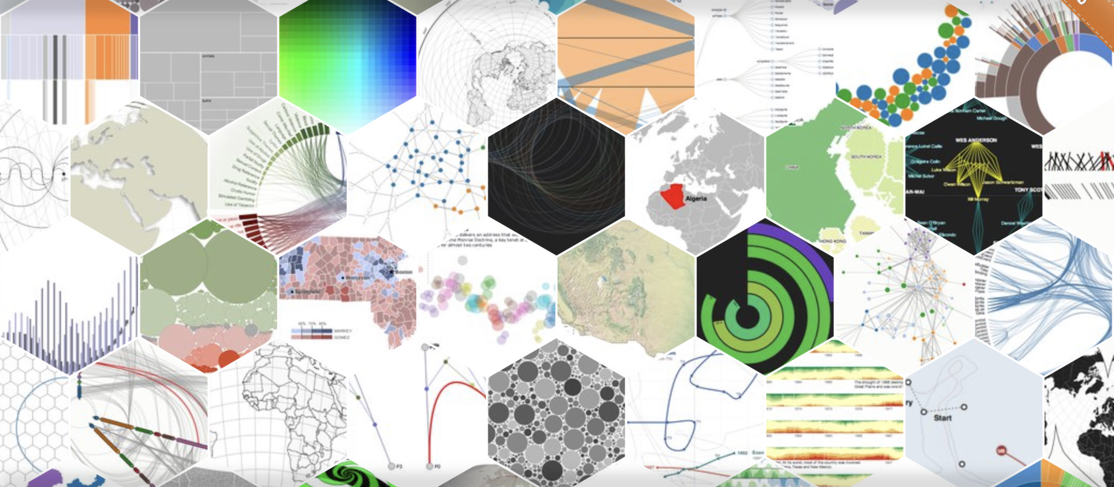
JavaScript example
Not to be disparaged! Prepare your data; output as .json. Have your webpage (with javascript) just load your data and ta-da! A visualization! [and we have a demo]
Check out d3js.org for a sample of the many types available.

Slide 13
Python example
import matplotlib
import matplotlib.pyplot as plt
%config InlineBackend.figure_formats = ["retina"]
import numpy as np
x = np.linspace(0, 5, 10)
y = x ** 2
figure()
plot(x, y, 'r')
xlabel('x')
ylabel('y')
title('title')
show()
fig = plt.figure()
axes = fig.add_axes([0.1, 0.1, 0.8, 0.8]) # left, bottom, width, height (range 0 to 1)
axes.plot(x, y, 'r')
axes.set_xlabel('x')
axes.set_ylabel('y')
axes.set_title('title');
read each line - know why it is there.
what’s up here?
… breakout activity time

Slide 14
Examples & Resources
In the resources folder
DataVis_1_Matplotlib.ipynb
DataVis-extra-fyi.ipynb
Python for Data Analysis (text)
“Cheet Sheets”
InfoVis texts tend to cluster by some main themes:
“Empirical” school (Stanko, Ware)
Data over People (Mutzner, Illinsky & Steele)
Communication (Benoît, Heer)

Slide 15
Resources; White Papers
Benoît (2019) Introduction to information visualization
Ware Information visualization and Design for visual thinking
Tufte Visual display of quantified data, Visual explanation, Beautiful evidence, etc.
Steele & Illinsky Beautiful information [series of articles]
Börner, K. Atlas of knowledge and Atlas of science [various demos of one-off examples]
Munzner Visual analysis and design
IEEE Visualization [professional organization]
ACM SIGVIS [professional organization]
Information visualization (journal)
Gartner “Not all BI platforms are created equal”
Bobriakov (2018) Comparative analysis of …
Tableau (homepage; download and try for free)
About 10 years ago, ACM’s lead article was “Should we teach graphic design to computer science students?”

Slide 16
Summary
“data” versus “information”
Your exposure and your & others’ growing expectation of visualizations in data-rich environments
Explain, Explore, Predict … with statistical and other data to back up and clarify potential interpretations
Code-your-own: matplotlib, seaborn, many others for python
JavaScript and others for web-based presentations
Tableau and other products
Know your data; know your audience; learn graphic design (!) and integrate the whole in your code.
Enjoy the Beautiful in Information!

